Slide 1
SonarQube – Static Code Analysis
Presented by : Swati Magar

Slide 2
Agenda
Static code analysis
Sonar - Continuous Code quality management
7 axes of code quality
SonarQube platform overview
Code Coverage/Report
Security in SonarQube
Quality Profiles, Quality Gates
SonarQube Analysis modes
Integration with other tools
Demo
Q&A

Slide 3
Static Code Analysis
Code debugging without executing the program
Provides an understanding of the code structure
Checks for coding standards in program
Code as per industry standards
E.g. SCA tools : - SonarQube, Code Climate, Checkmarx, SourceMeter

Slide 4
SonarQube–Continuous Code Quality Management
Open platform to manage code quality, developed by SonarSource
Written in Java and Ruby
It covers the 7 axes of code quality
It is a Continuous Inspection process, raising code quality visibility for all stakeholders
Covering 25+ languages (50+ plugins)
Combine metrics altogether with historical data
It provides efficient dashboard

Slide 5
7 issues identified by Sonar
7 Deadly sins of developers identified by sonar team :-
Non respect of coding standards & best practices
Lacking comments in source code, especially in public APIs
Having duplicated lines of code
Having complex component or/and a bad distribution of complexity amongst components
Having no or low code coverage by unit tests, especially in complex part of the program
Leaving potential bugs
Not following architecture and design

Slide 6
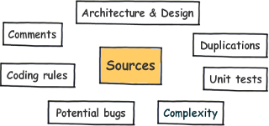
7 axes of code analysis

Slide 7
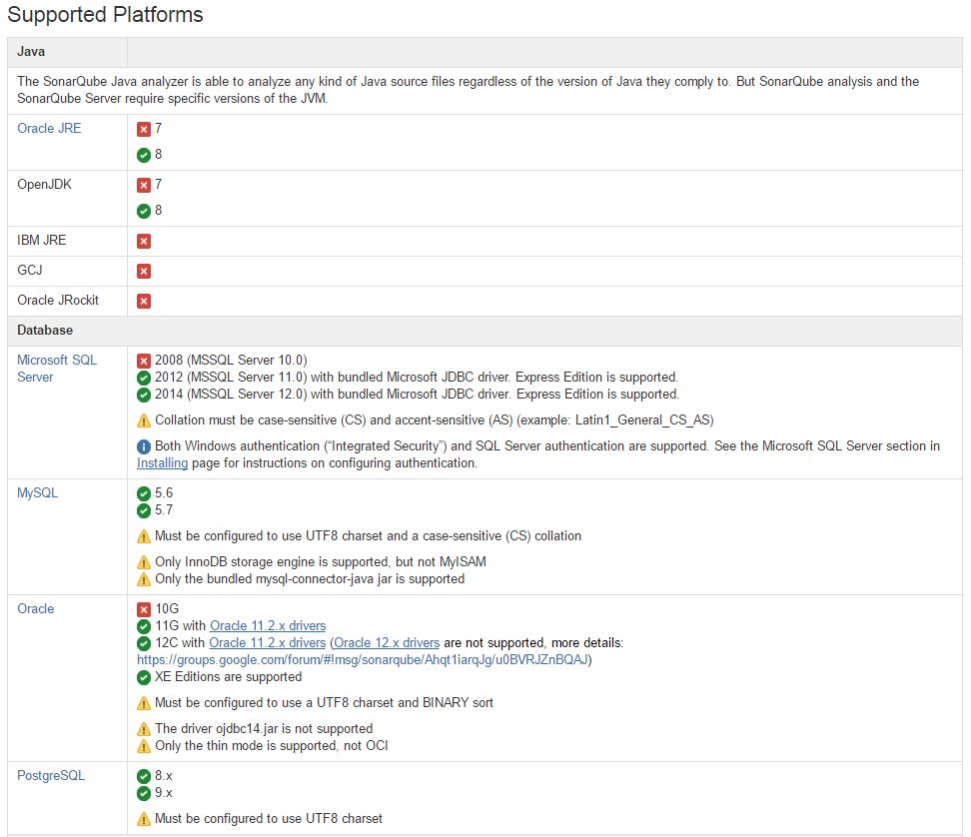
SonarQube Prerequisites
SonarQube 5.6.x (LTS)

Slide 8
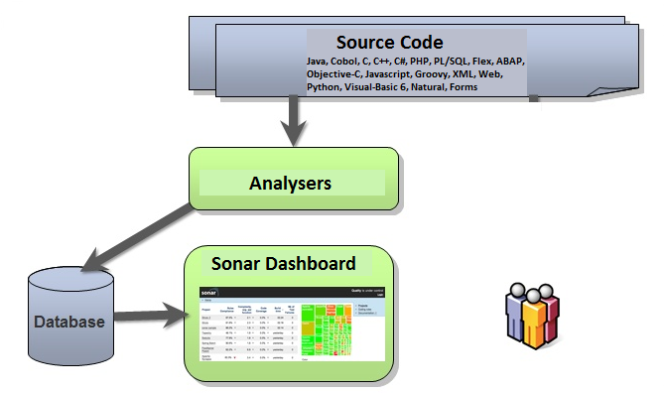
SonarQube Platform Overview
SonarQube 4.5.x (LTS)
SonarQube 5.6.x (LTS)

Slide 9
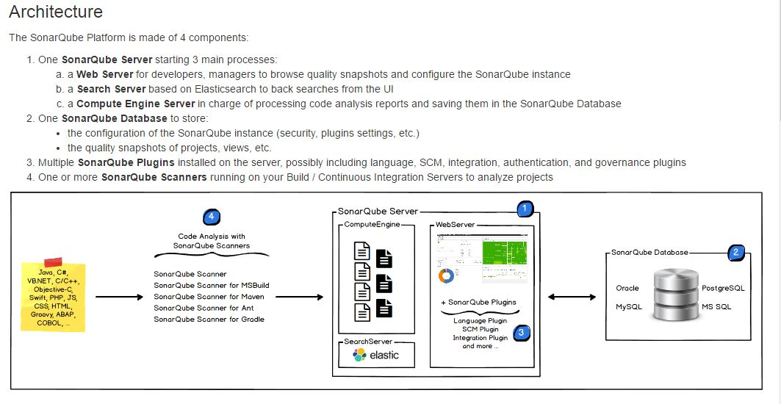
SonarQube Platform Overview -5.6.x (LTS)

Slide 10
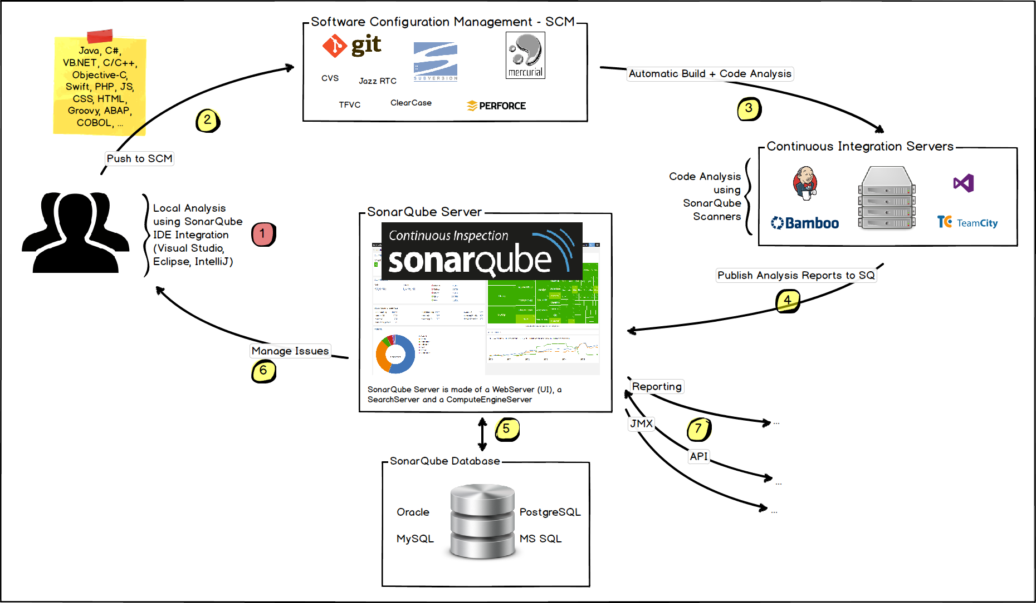
SonarQube Platform Overview
SonarQube 5.6.x (LTS) with CI Servers

Slide 11
Code coverage/Report
Showcase Unit tests execution and code coverage reports
Unit test Code coverage- lines of code covered by unit tests
Supported code coverage tools
JaCoCo
Cobertura
Clover
Coverage
PDF/HTML -Report generation of issues, project PDF report only in SonarQube 4.5.x version

Slide 12
Security in SonarQube
Mechanism to manage security (User, Group)
Restrict access to a project to a given group of users
Administration permission for project (exclusion patterns, configuration for that project, etc.)
Configuring security use cases :
Manage access rights to components, information, etc.
Enable customization (custom dashboards, notifications etc.) of SonarQube for users

Slide 13
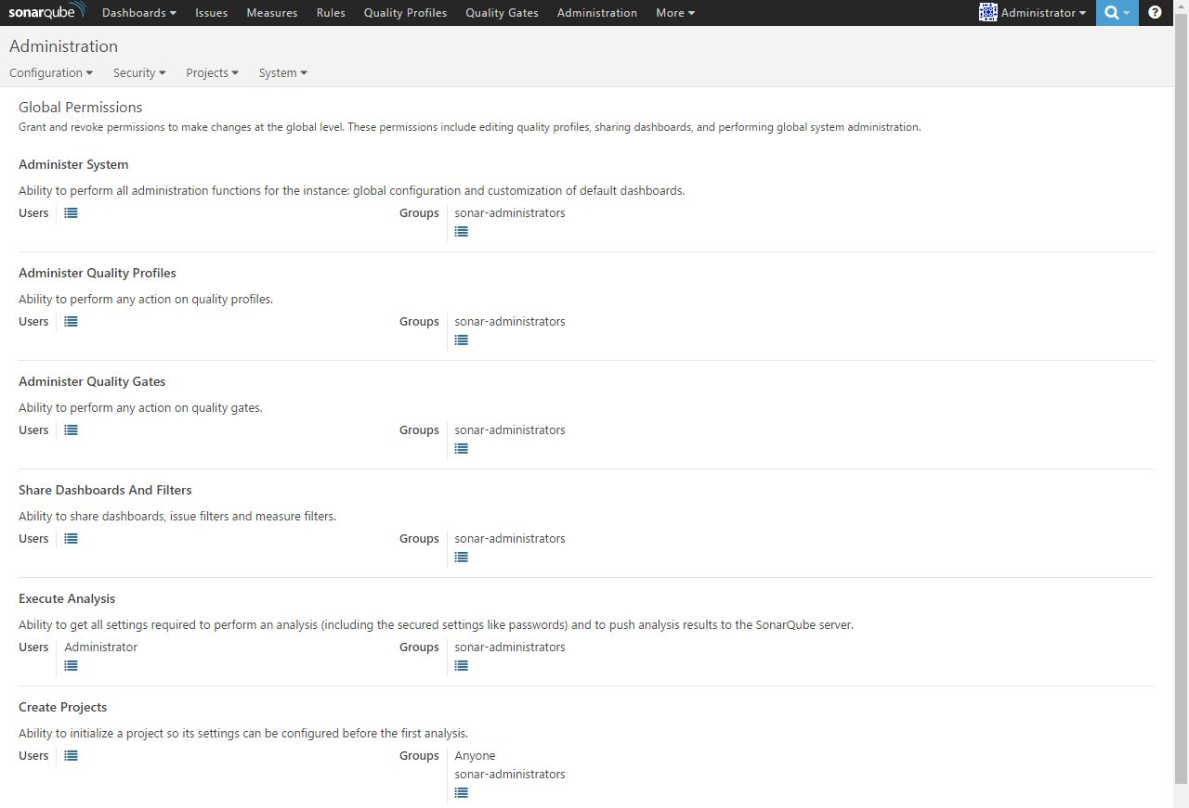
Global Permissions

Slide 14
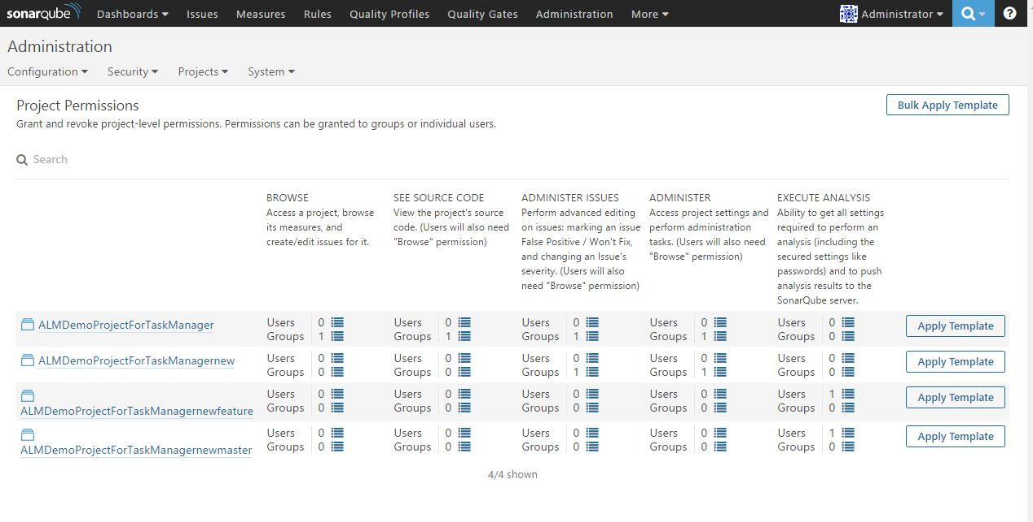
Project Permissions

Slide 15
Quality Profiles
Requirement by defining set of rules for project
Same or different profile for multiple project
Technological implementation specific quality profile e.g. Java, PHP, JS etc.
Create custom profiles for projects
User access security in Quality Profile- Project administrator
Rule configuration- Activation/Deactivation/Modification

Slide 16
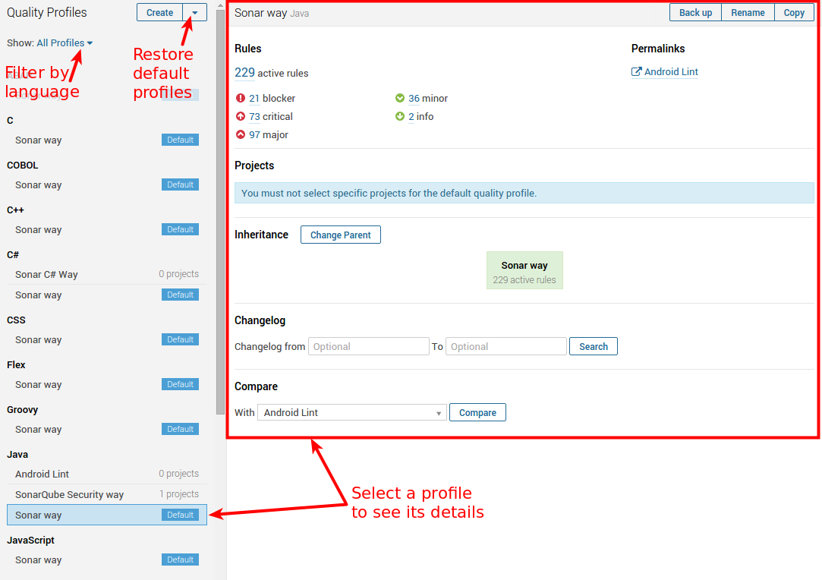
Quality Profiles

Slide 17
Quality Gates
Set of Boolean conditions to measure thresholds of projects E.g. - No new blocker issues
- Code coverage on new code greater than 80%
One Quality Gate for multiple project
Create Project specific Quality Gates
User access security in Quality Profile- Project administrator
Multiple conditions
E.g. -measure: Blocker issue
-period: Value
-comparison operator: >
-error value: 0

Slide 18
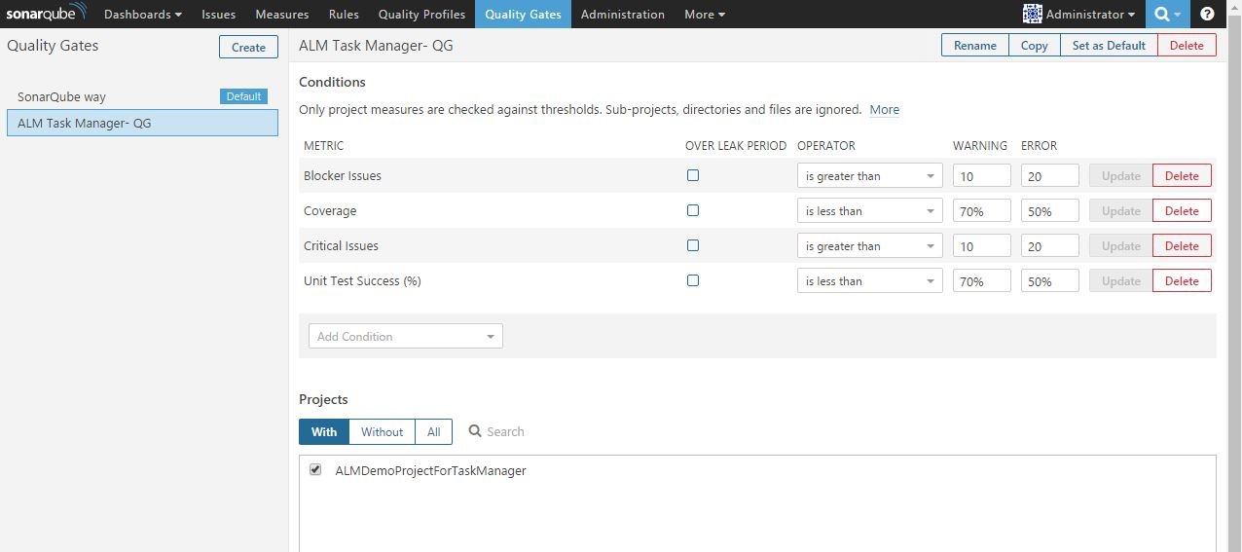
Quality Gates

Slide 19
SonarQube - Analysis Modes
Analysis – Default mode, to perform a full analysis
– Store result in database
Preview – Previously known as the dry Run mode. – Performs a full analysis, but doesn’t store the results in the database
– Store data in HTML report
Note:-As per SonarQube 5.6.x (LTS) version

Slide 20
Integration with tools
Jenkins, Bamboo (CI engine)
IDE plugin (Eclipse, Visual Studio)
Maven
Ant
Gradle.

Slide 21

Demo

Slide 22
Any Questions?

Slide 23
Thank you!

